Slide 1
Retail Sales Analysis 2024
End-to-End Data Analytics Project

Slide 2
Key Metrics
Total Revenue: 2,348,363.17
Total Profit: 658,333.01
Avg Order Value: 225.59
Orders: 10,410
Units Sold: 16,032
Profit Margin: 28.03%

Slide 3
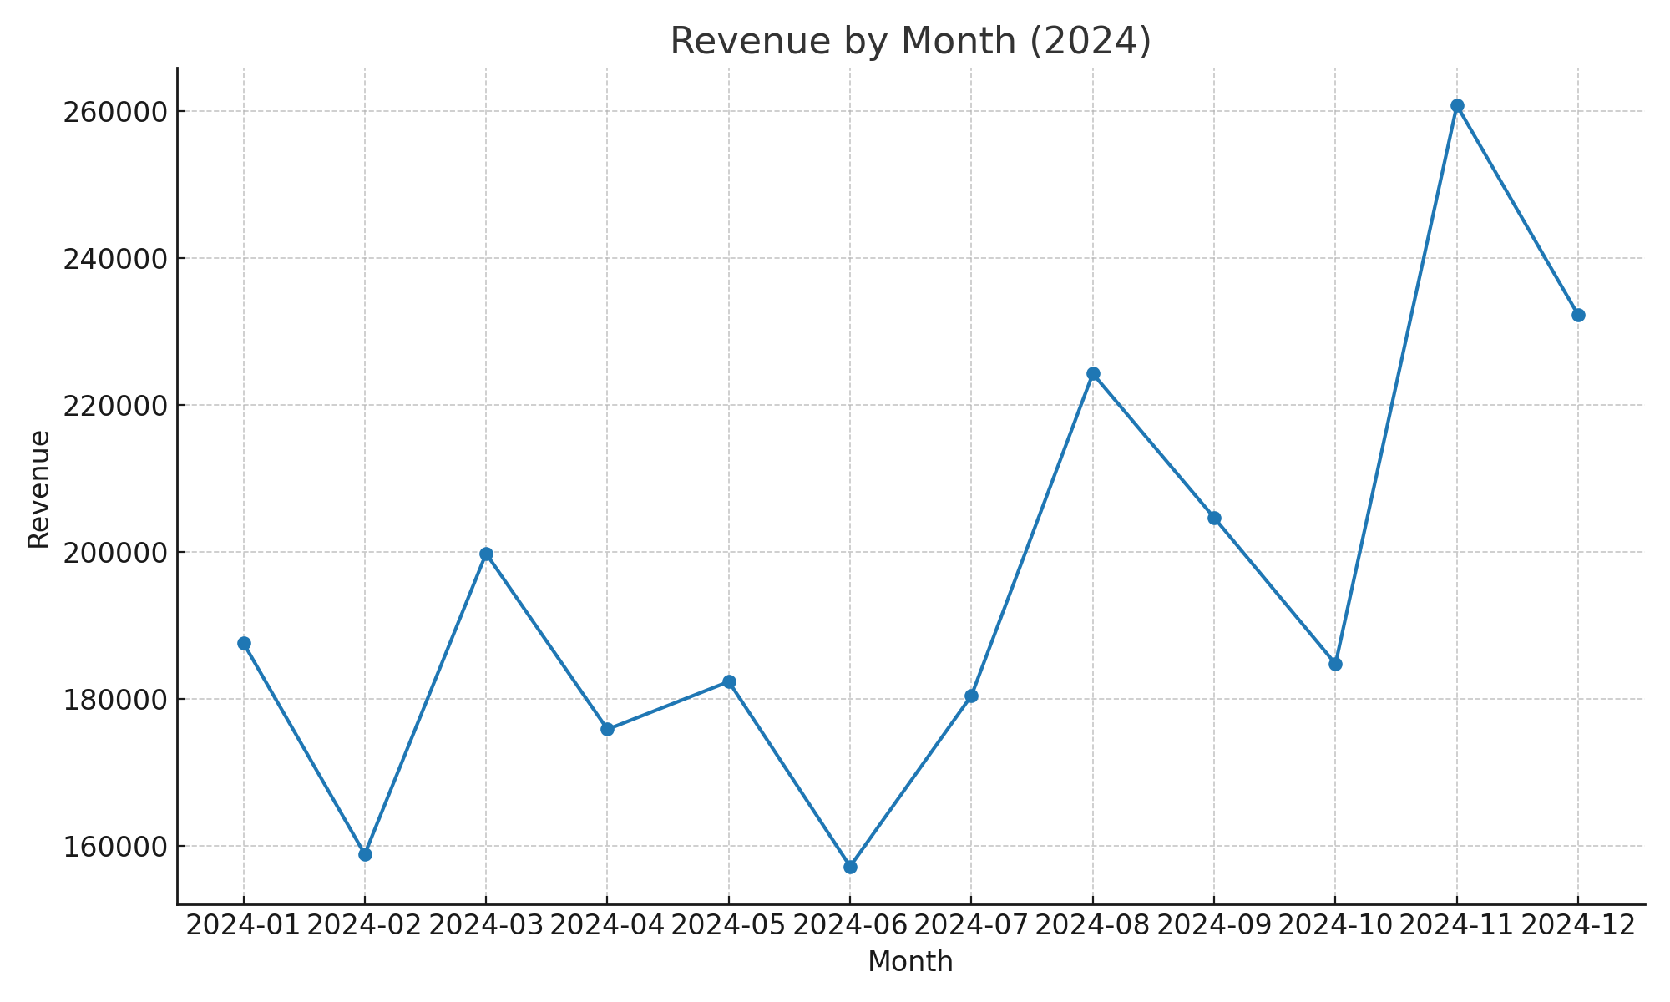
Revenue by Month

Slide 4
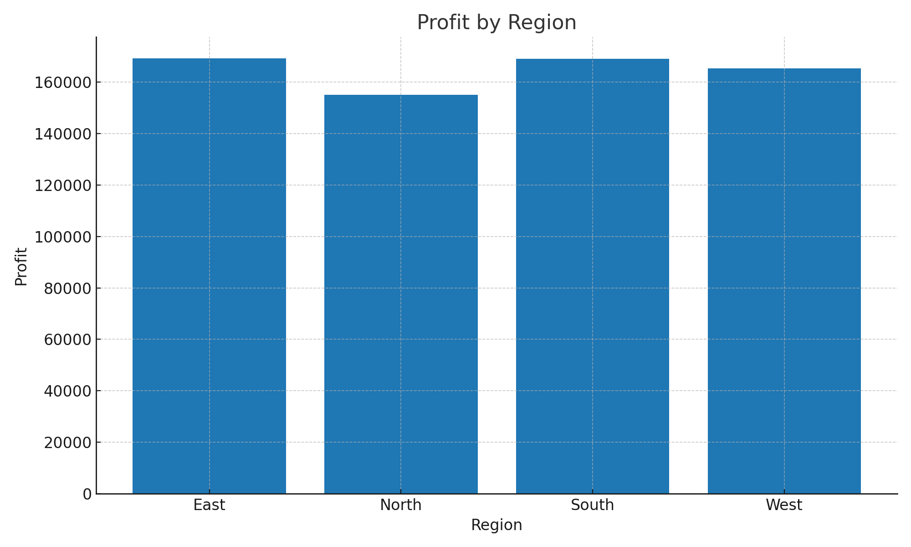
Profit by Region

Slide 5
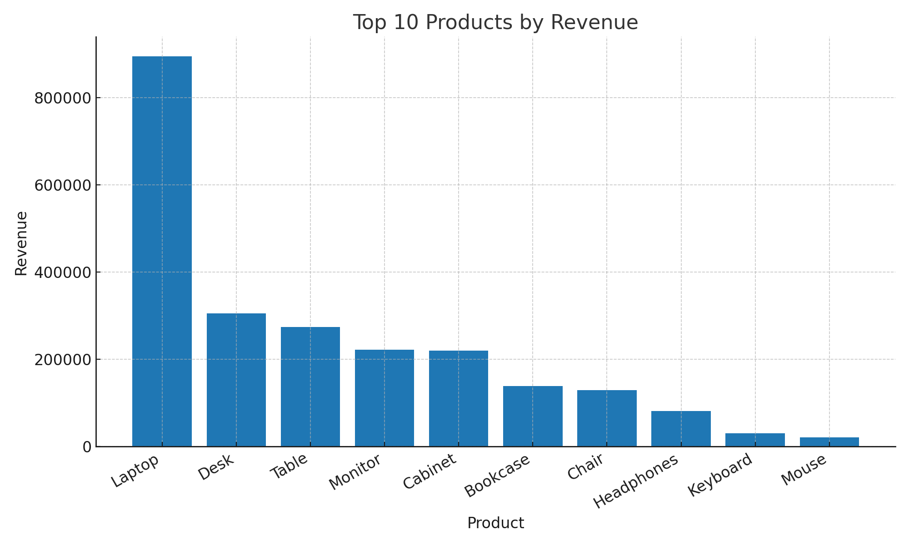
Top 10 Products by Revenue

Slide 6
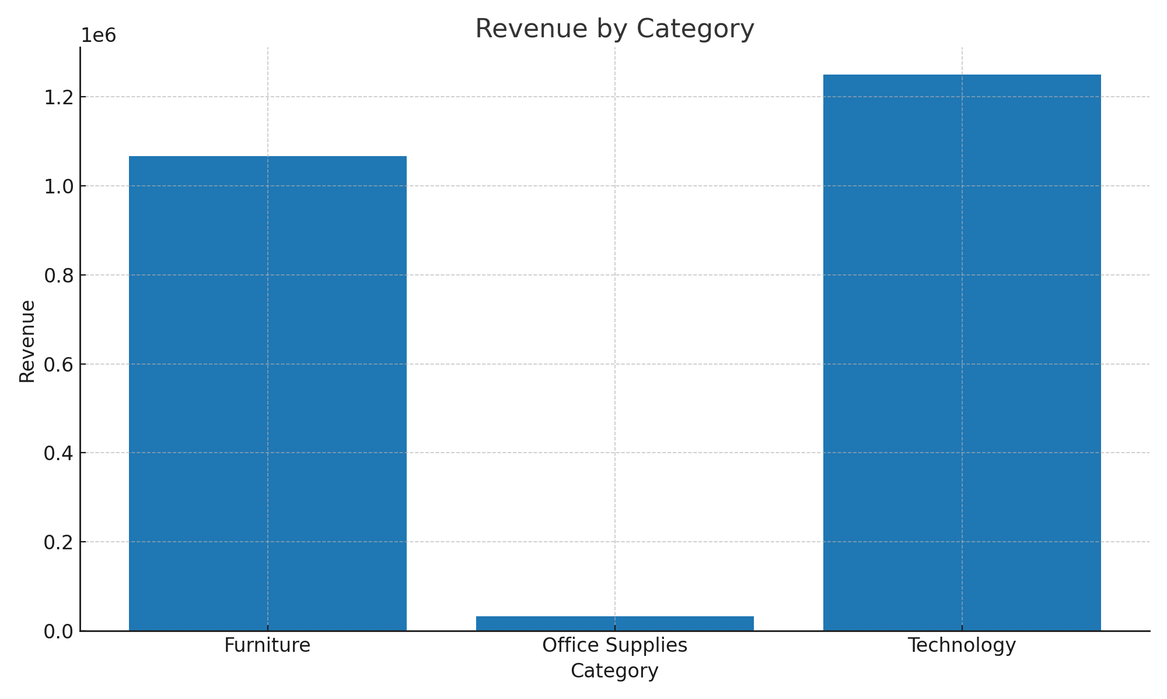
Revenue by Category

Slide 7
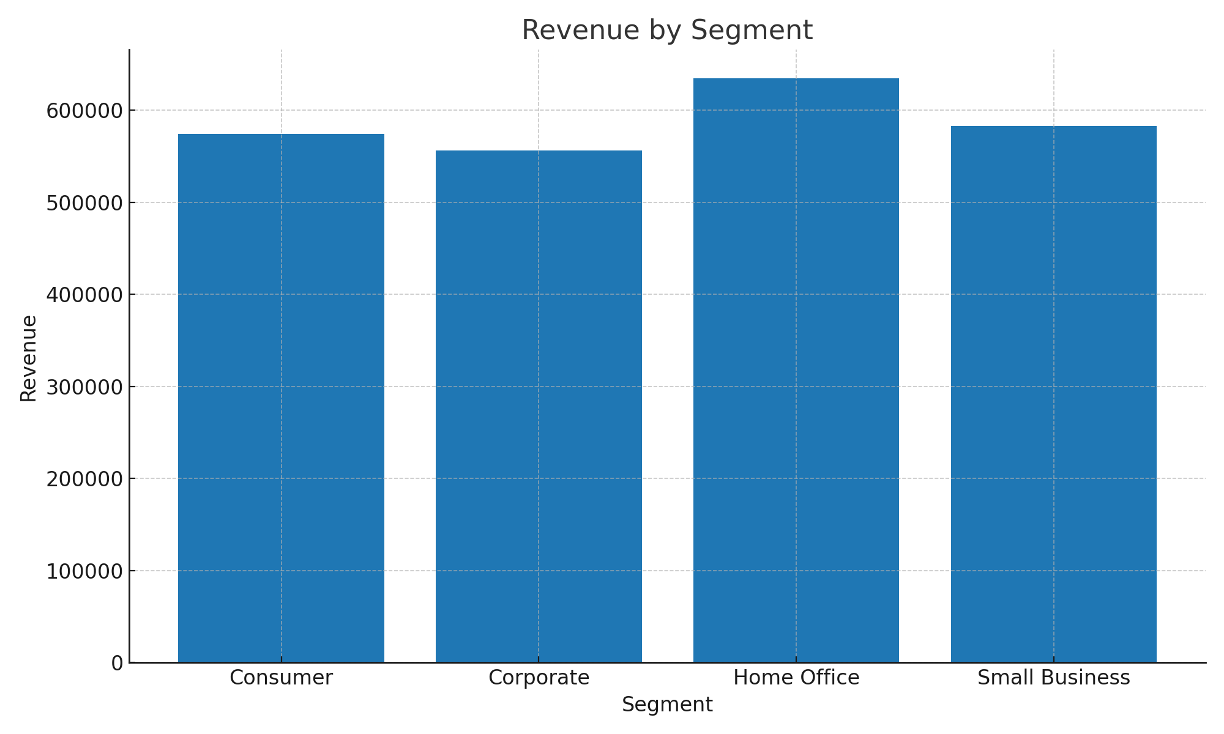
Revenue by Segment

Slide 8
Executive Insights
• Seasonality peaks in Aug–Sep and Nov–Dec.
• Technology leads revenue; Laptop & Monitor are top drivers.
• West & North regions lead profit; focus growth in South/East.
• Consumer & Corporate are key segments.
• Maintain margins via targeted discounts.

